Slide 1

COVID-19 EXPLORATORY ANALYSIS USING SQL
Muthalib Abdul

Slide 2
INTRODUCTION
This project involves the use Covid-19 data and performing some basic data cleaning, data manipulation, and lastly data analysis to interpret the outcome
Dataset used: https://github.com/owid/covid-19-data/tree/master/public/data
Steps:
Download Covid Deaths & Vaccinations data
Performing data cleaning in excel (removing columns)
Importing data into MS SQL server
Performing data manipulation and data analysis
Interpreting Results
This presentation will showcase the code with the output in each slide
If you are interested in viewing just the syntax, you can find it here <URL>
Link to this project repository (GitHub) <URL>
Link to main portfolio <URL)
Questions :
Which country has the highest infection count/percentage
Which country has the highest death count/percentage
Produce a rolling vaccination count for each location and date

Slide 3
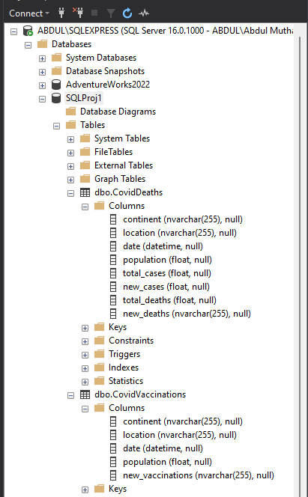
DATABASE OVERVIEW
Here we have the database name "SQLProj1" that has 2 datasets
CovidDeaths
CovidVaccinations
Each dataset has set number of columns that we will use to do our analysis
We can also see the type of data and if null values are allowed within the columns

Slide 4
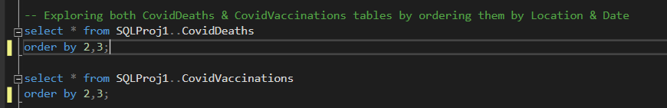
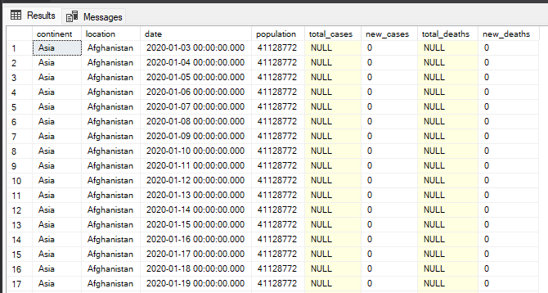
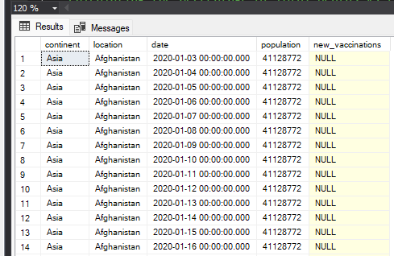
DATA EXPLORATION
We use the simple select statement to select all variables from both the tables and then order the table by 2(location) and 3(date).
Initially, null values are expected for all countries as we had no means to confirm a positive case

Slide 5
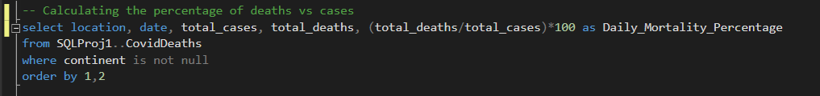
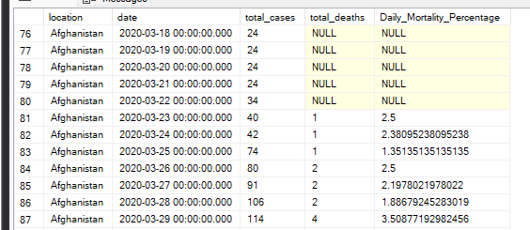
DATA MANIPULATION
Here we analyze the percentage of people that succumb to the disease vs total case.
The new column Daily_Mortality_Percentage is a calculated field

Slide 6
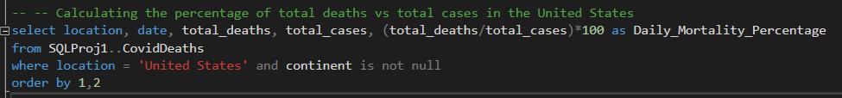
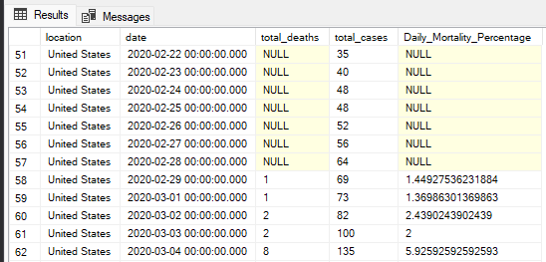
DATA MANIPULATION Cont...
In this part, we check the mortality percentage in the "United States" by adding a simple where clause.
We can observe initially we had null values and gradually number started to rise consistently as more an more people where diagnosed with the illness as well as succumbed.

Slide 7

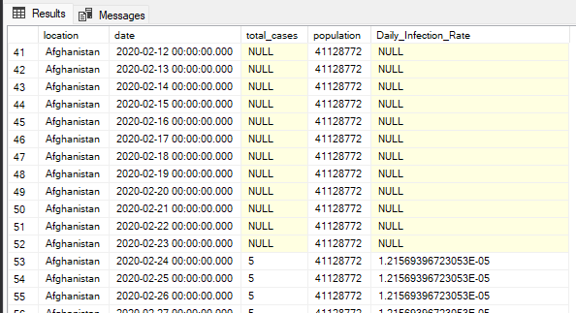
DATA MANIPULATION Cont...
Next we calculate the infection rate in all "location" by using the total_cases and population and we see a similar trend of rising infectious rate

Slide 8
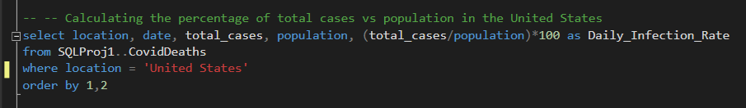
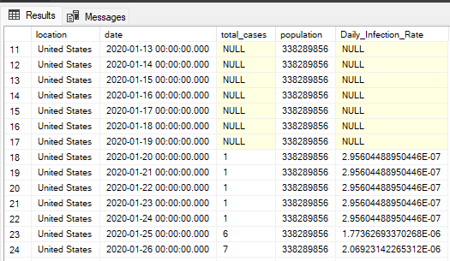
DAA MANIPULATION Cont...
Next we calculate the infection rate in the "United States" by using the total_cases and population and we see a similar trend of rising infectious rate

Slide 9
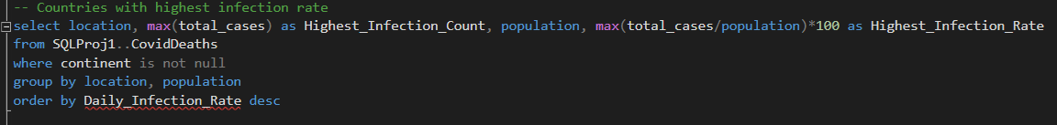
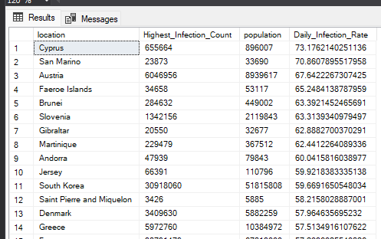
DATA MANIPULATION Cont...
Next, we use the max of total_cases and group by location & population to get the max infection rate for that location

Slide 10
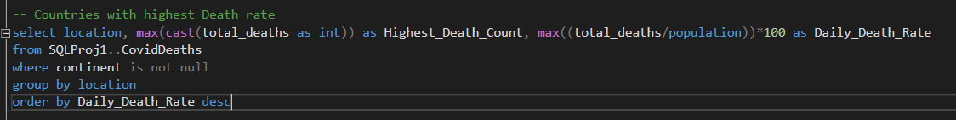
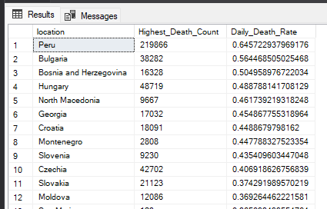
DATA MANIPULATION Cont...
Here we check the highest death count and death rate by every location.
We also use the cast function to convert data type to int to make the calculation possible

Slide 11
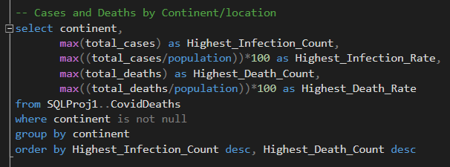
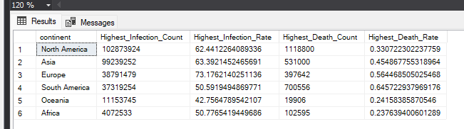
FINAL ANALYSIS
Here we take the max of total cases and its percentage, max of total deaths and its percentage and group the output by "continent"

Slide 12
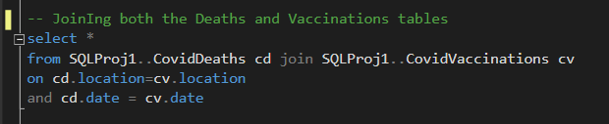
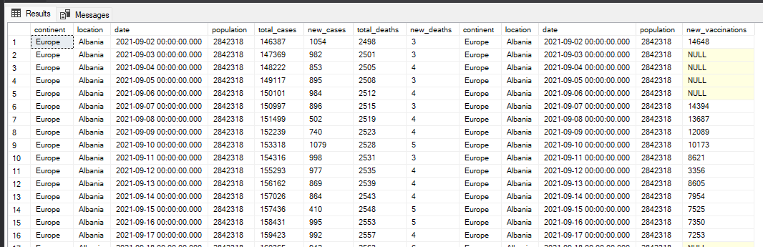
DATA MANIPULATION Cont...
In this step, we join both the data sets (Deaths & Vaccinations) on two variables, location and date.
We also make sure we only keep the variables that we are interested in

Slide 13
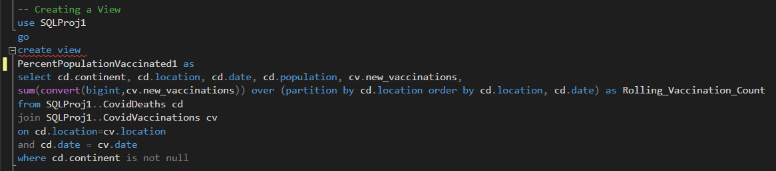
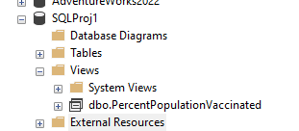
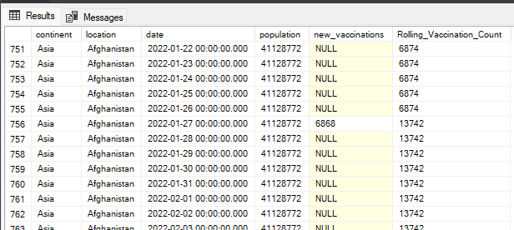
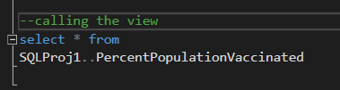
FINAL ANALYSIS
Lastly we produce the vaccination rolling count for each location and date and save this data set as a view by using simple create view function
The view is saved within the views tab and we can directly call the table by using select statement

Slide 14


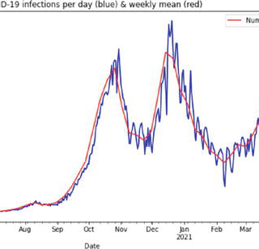
Thank you
Muthalib Abdul

